Slide 1
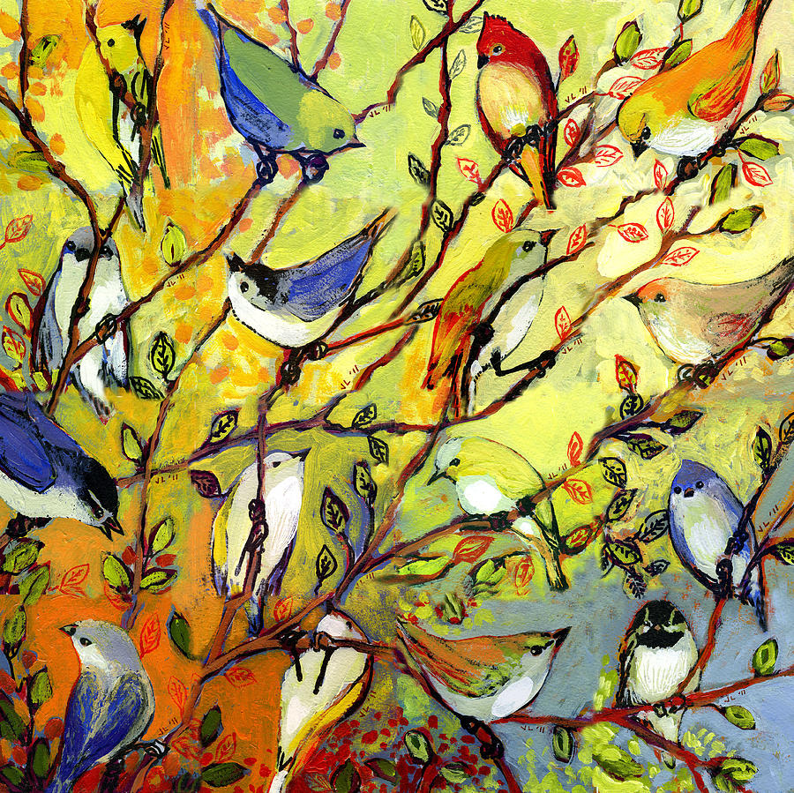

Birds of a feather, flock together
Julie Walters
GFWC Georgia Third Vice President
membership@gfwcgeorgia.org

Slide 2
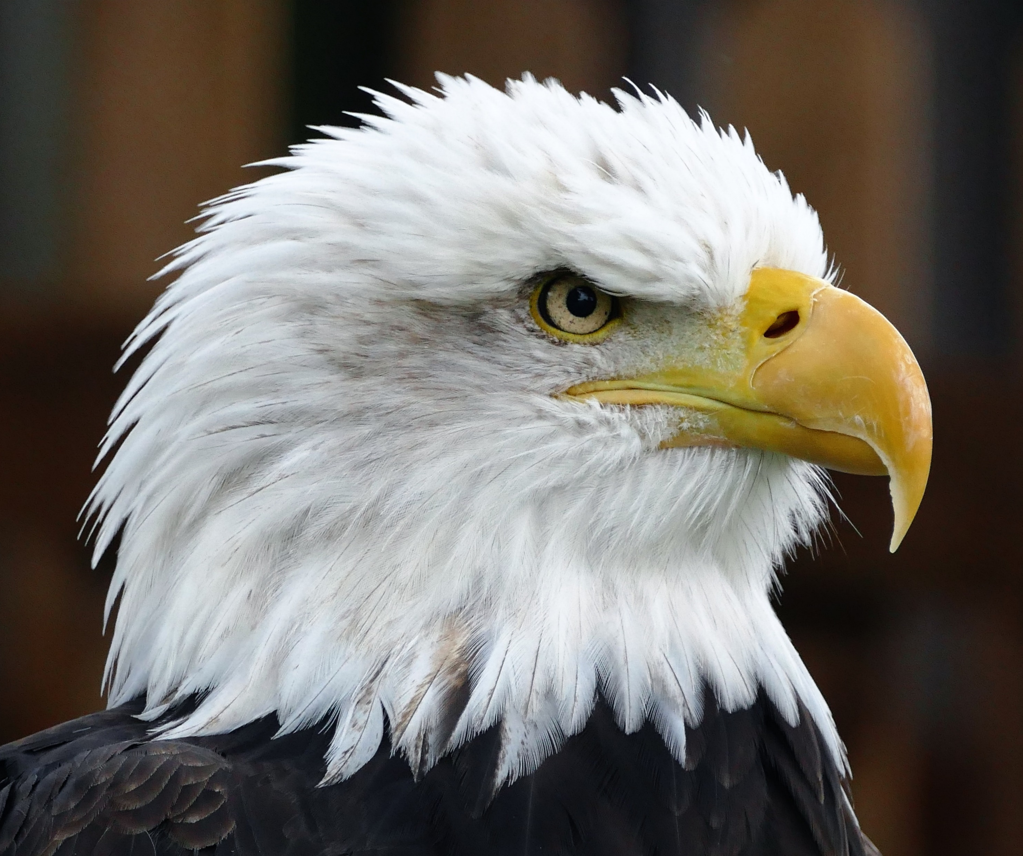
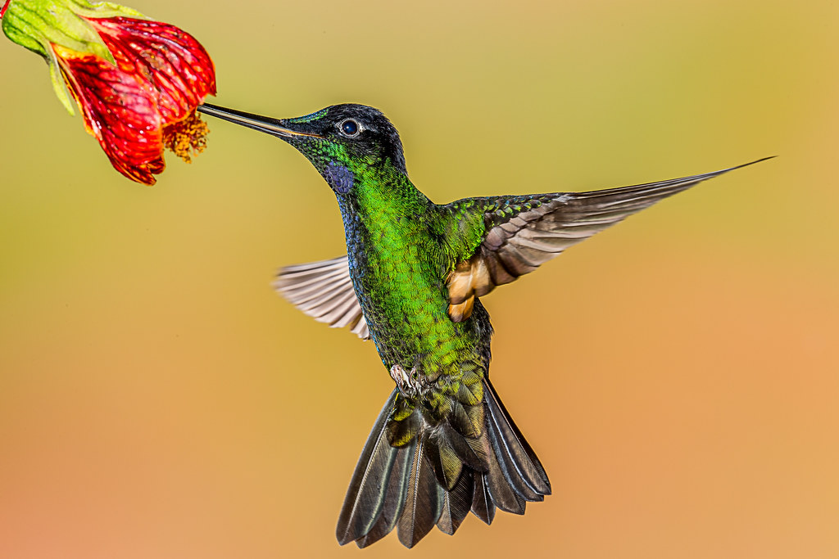
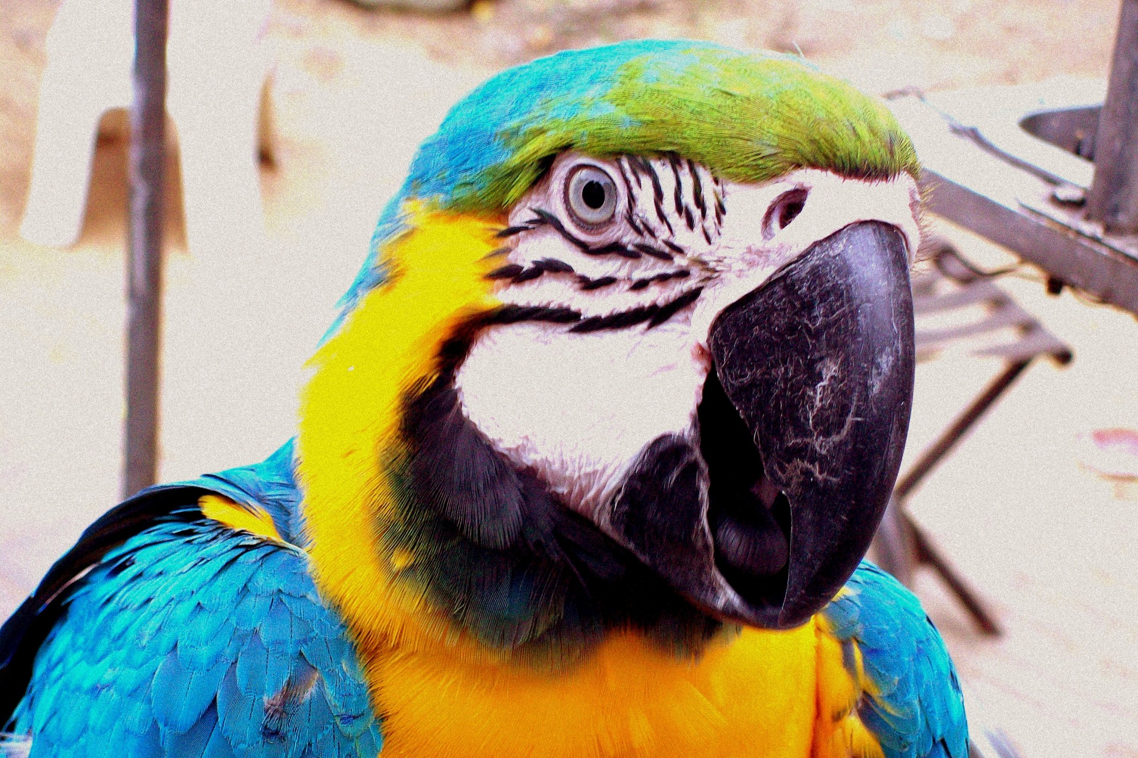
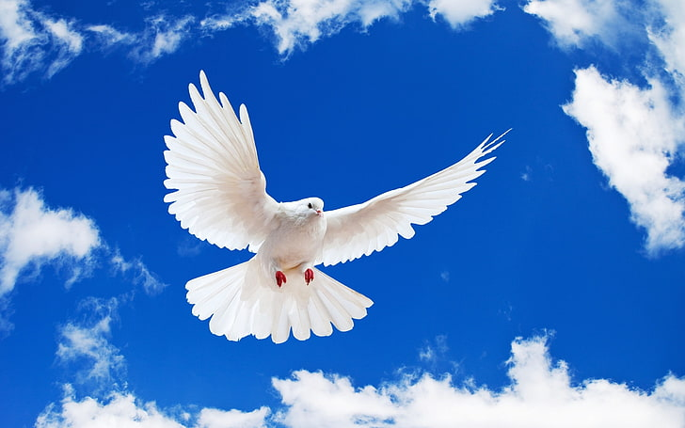
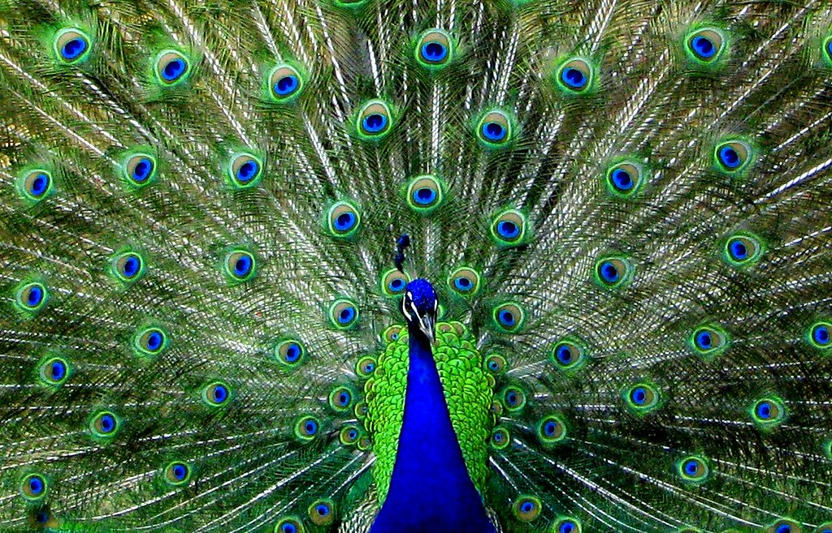
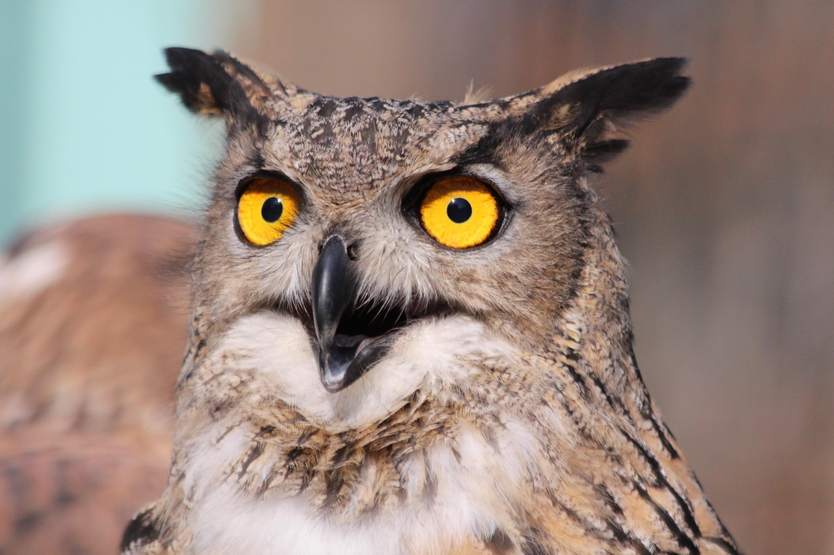
There are all types of birds in our world.
The busy hummingbird.
The wise owl.
The chatty parrot.
The peaceful dove.
The showy peacock.
The bold eagle.
The overbearing hawk.

Slide 3

Club women can be like birds.
Some clubwomen are busy, some are wise, some are chatty, some are peaceful, some are showy, some are bold and yes, some are overbearing.
And just as we need all types of birds, we need all of these types of club women.

Slide 4
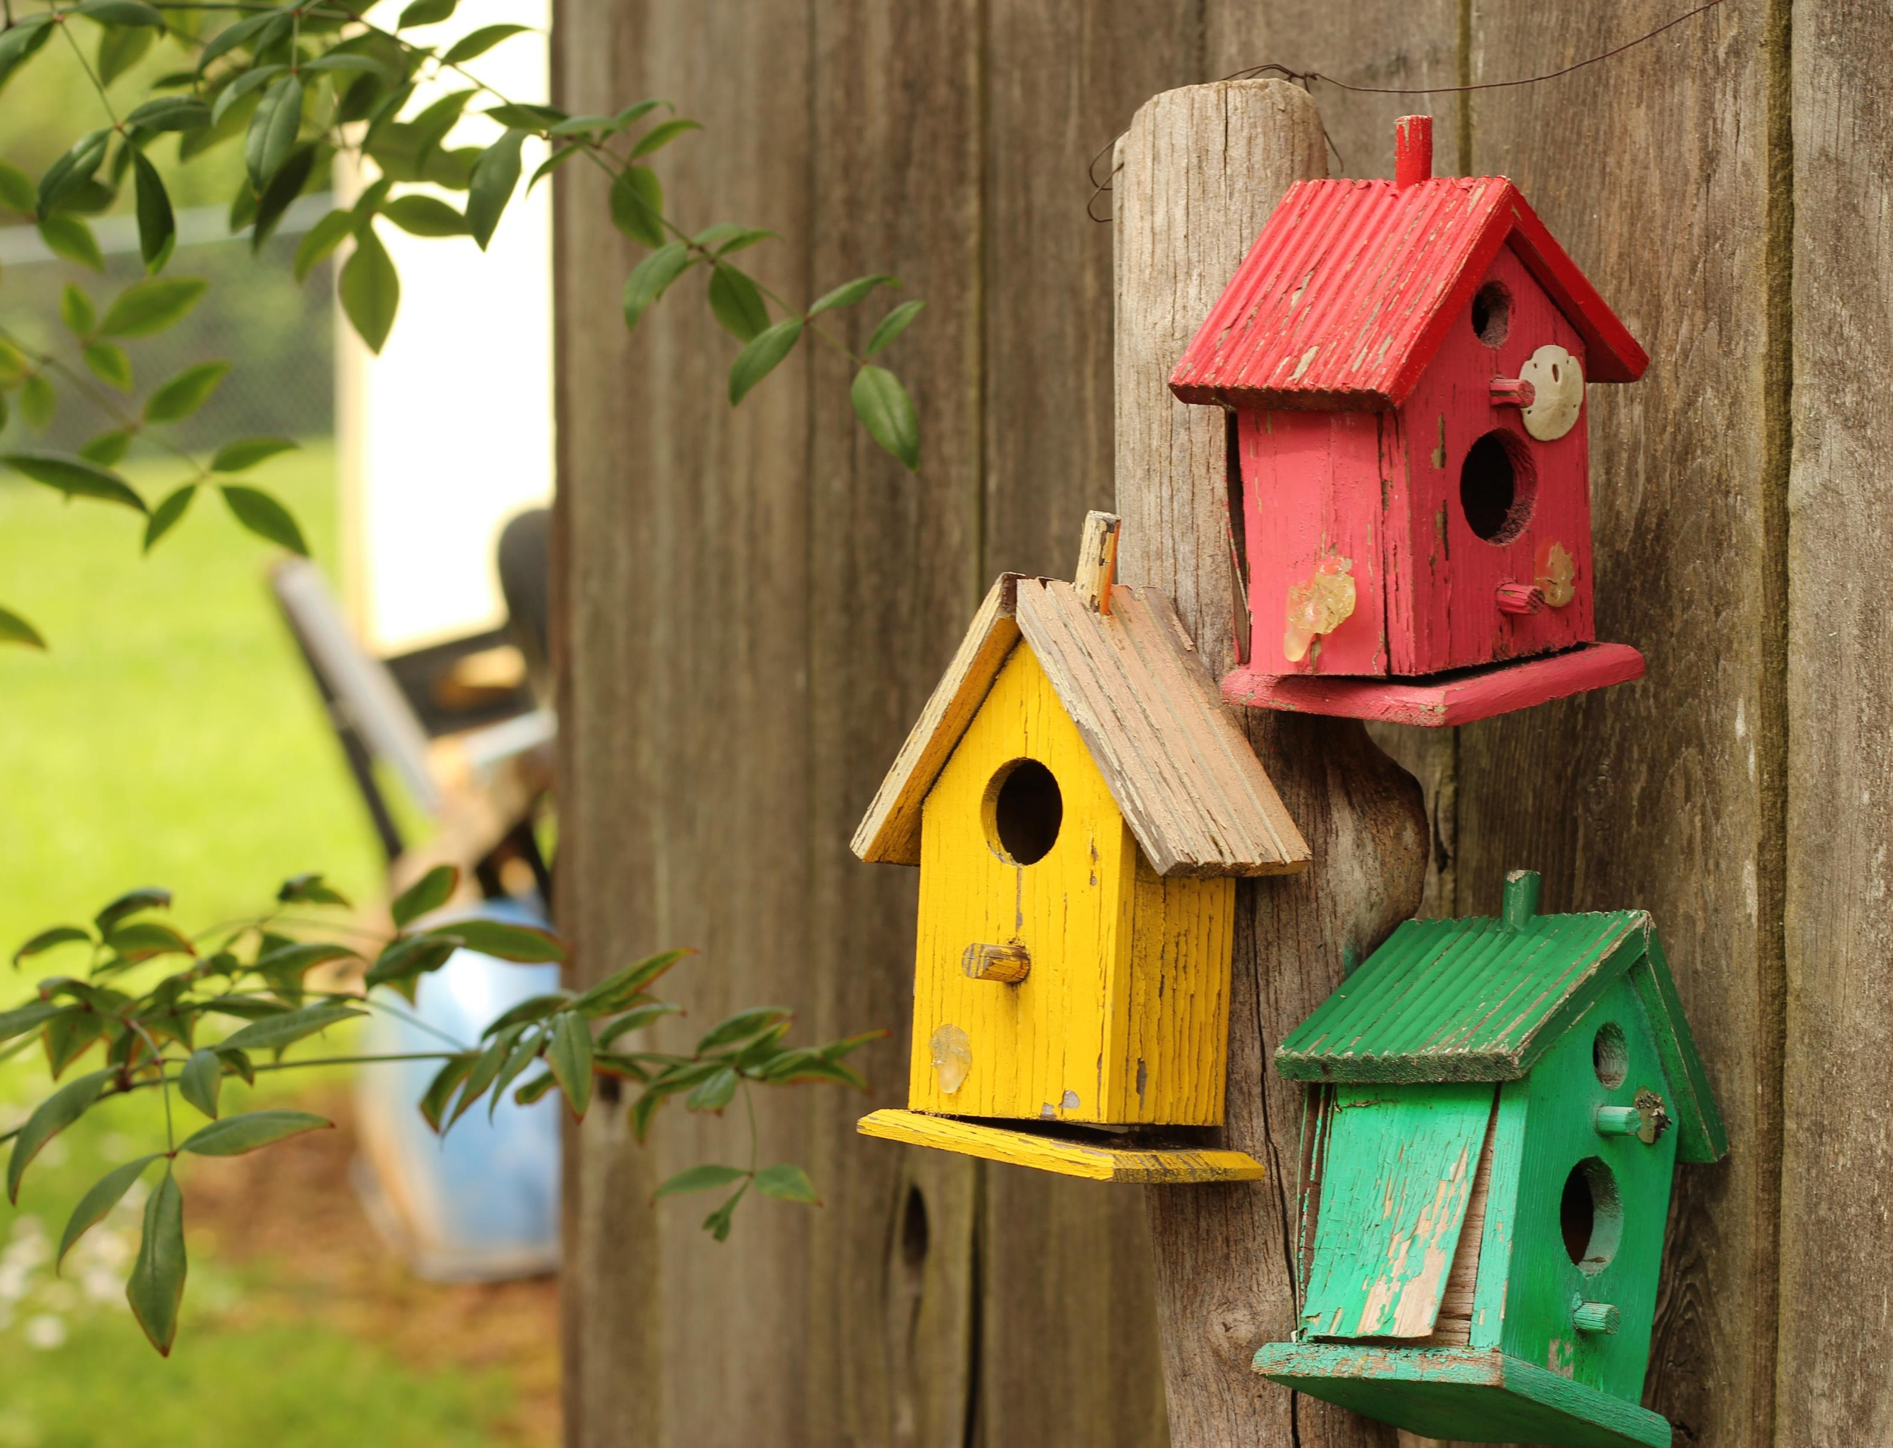
Our goals for this administration will be to increase our membership while we retain our current members.
We will accomplish this by recruiting new members, forming new clubs and continue to offer volunteer opportunities for our members.
We will be building new bird houses and welcoming new birds in.

Slide 5
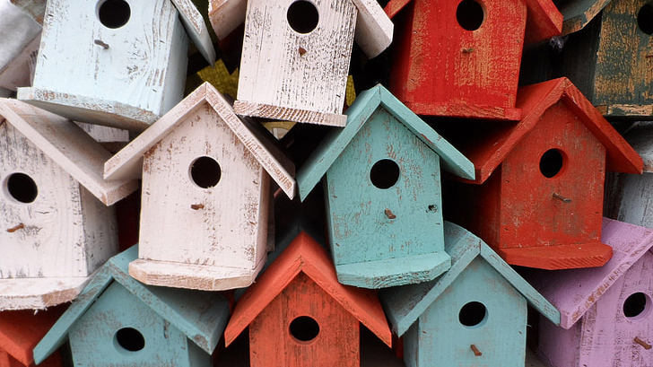
What is the status of your bird house?

Slide 6
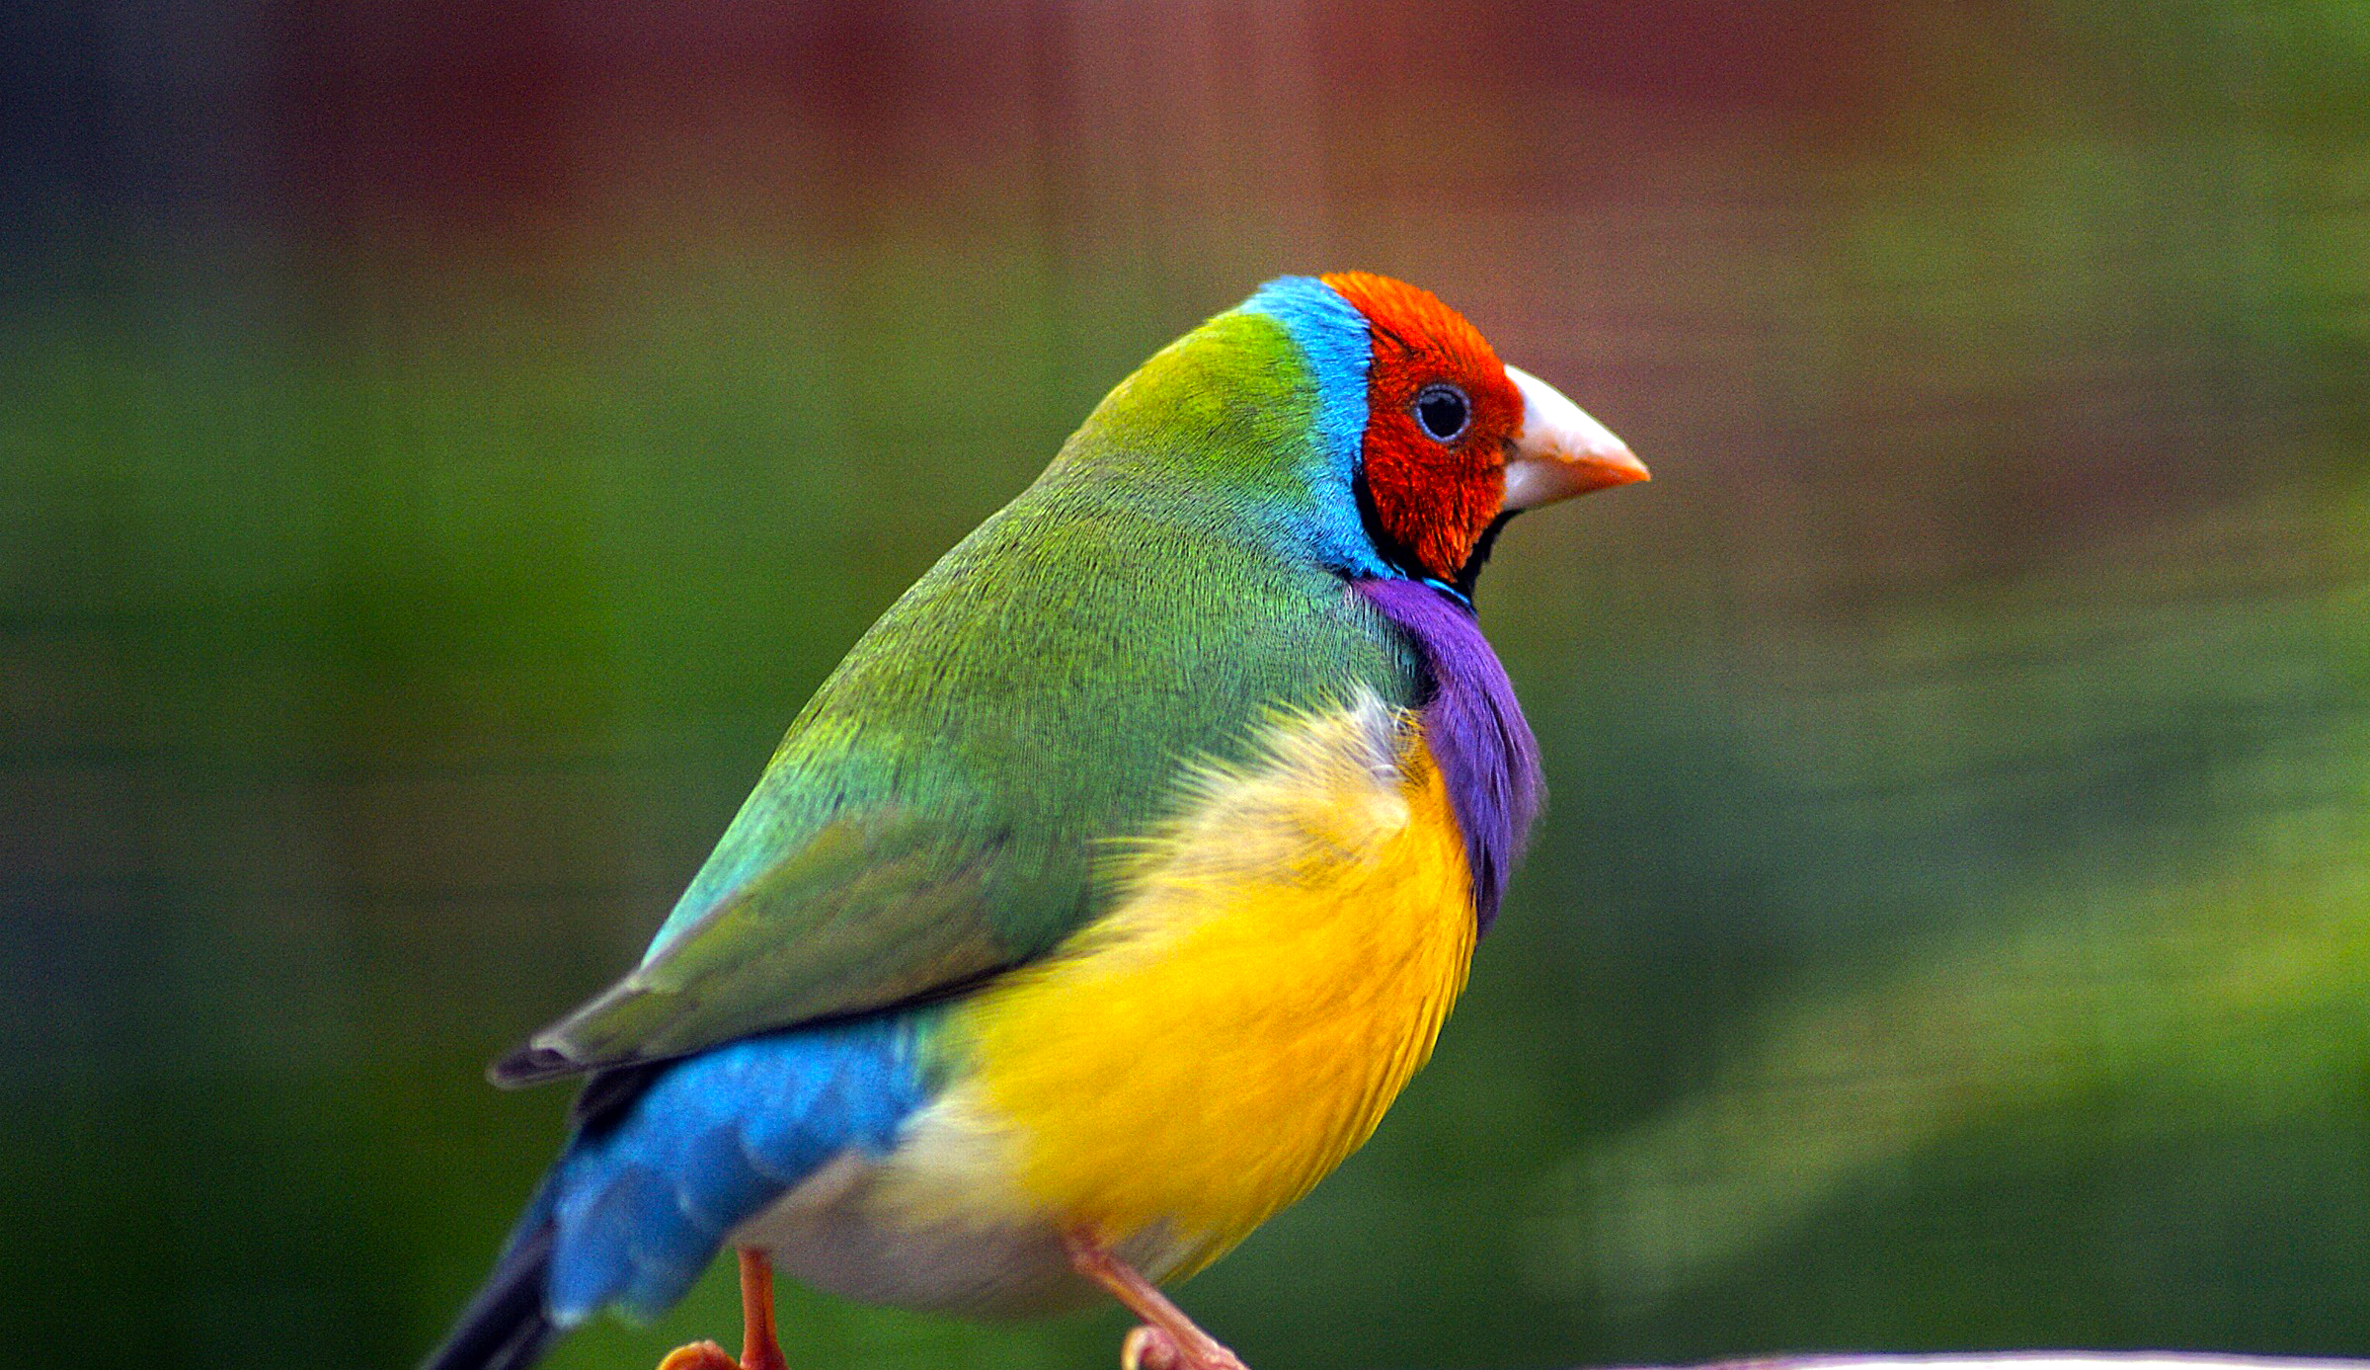
Welcoming New Birds

Slide 7


Focus on REALTORS

Slide 8
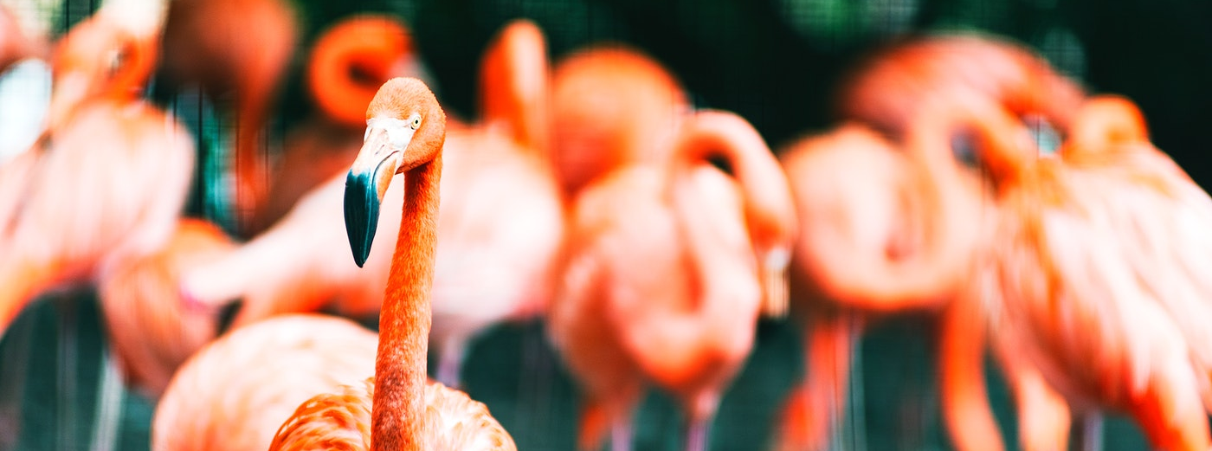
Retention
Keeping your flock together

Slide 9
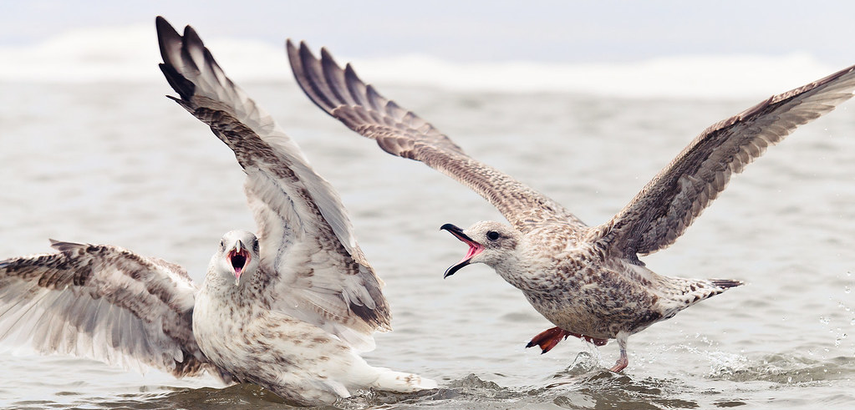
Bird Fight

Slide 10
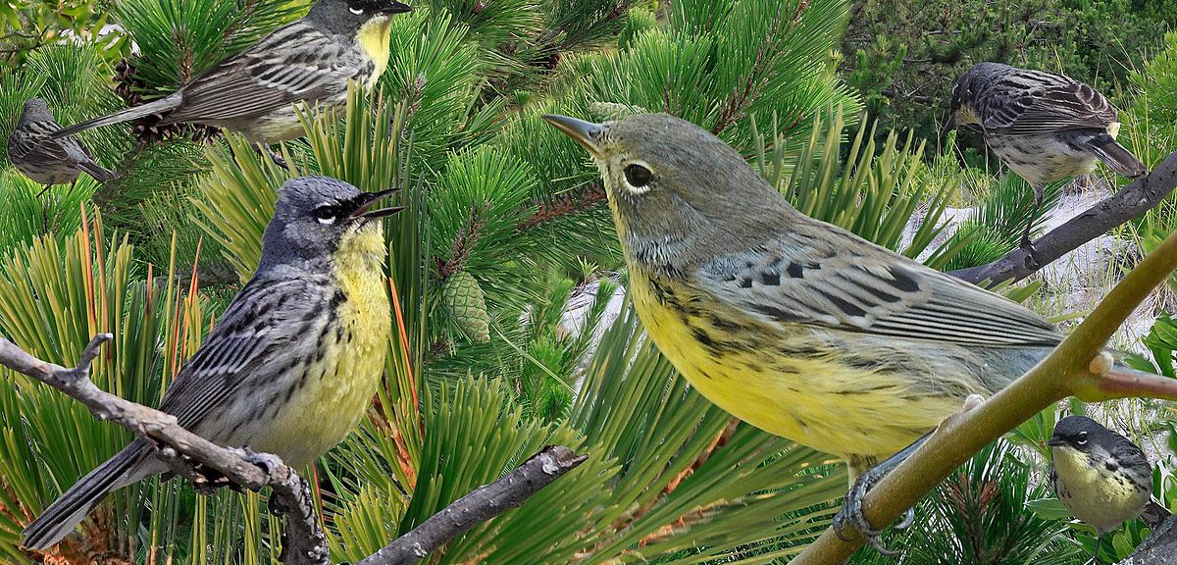
Why did you join?

Slide 11

Email Julie at membership@gfwcgeorgia.org

