Slide 1

GFWC LEADS 2020
Training Elected Officers and Community Service Programs Chairs

Slide 2


Agenda
Types & Tips for Training
Specifics for GFWC Club Officers
Specifics for GFWC Community Service Program Chair
Succession Planning
Strategic Planning

Slide 3


Types & Tips of training
Expert versus facilitation
Tips
          Make your objective(s) clear – agenda
          Consider who is invited
          Stick to your schedule
          Take no hostages
          Start on time, end on time
          Ban technology
          Follow up – Evaluations

Slide 4

Specifics for Club Officers
        Ice Breaker
Responsibilities - By- Laws
Budget – Expense Reports
Parliamentary Procedure Motion form - anyone but President
Standing Rules
Reports - President - Leadership & Fundraising, 1st VP - Membership,
2nd VP - Reporting
Strategic Plan - assign an officer to lead
Succession Planning: Suggest have each officer find a club member to partner with and show them "the ropes" after that officer learns them.
Resources GFWC yearbook - LEADSHIP
Questions

Slide 5
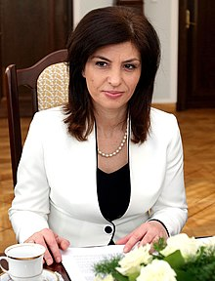
Specifics for CSP Chairs
        Ice Breaker
Responsibilities review handout
Budget - Expense Reports
Parliamentary Procedure - Motion form
Standing Rules
Meeting tips
Plan of Work
Partnerships
Questions

Slide 6

Succession Planning
Officers – find a member who you believe has the skills that will compliment the office and invite them for coffee or an adult beverage.
        CPS chairs – find a committee member who has a passion for your projects and work with them as a potential leader for next year or a current co-chair.
        Start the conversation – sometimes all it takes it the “ask”.
        Critical to success of your club longevity

Slide 7

Strategic Planning
Leadership
Membership
Finances
Governance
Community Outreach
Communications – Internal & External

Slide 8

“Hats off to Leadership”
GFWC LEADERS are
the BEST in the WORLD
HATS OFF TO THE 2020 LEADERS!

