Slide 1

GFWC GEORGIA:
Heart for Service
Notes:
Hello, everyone. My name is Cathy Jones and I’m the 2nd Vice President of the GFWC Georgia Federation of Women’s Clubs.
GFWC Georgia clubs and club women are the heart of not only the Federation, but the communities in which they live and work. For 130 years, GFWC volunteers have embraced the servant heart. Service to others is not a duty, but a response to love. The GFWC Plan of Work helps us focus on the best ideas of many generations of women who have a heart for service.

Slide 2


Organizational Plan
Notes:
GFWC has organized it’s plan for volunteer service in three tiers.

Slide 3
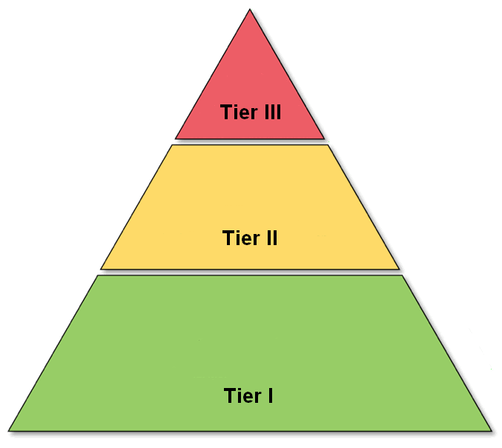
Notes:
Tier I contains our Community Service Programs. Tier II are the Advancement Areas. Tier III are the Special Emphasis Programs.

Slide 4

Community Service Programs (CSP)
Notes:
Let’s start with Tier I, our Community Service Programs or CSPs.

Slide 5
Community Service Programs 2020-22
Arts & Culture
Civic Engagement & Outreach
Education & Libraries
Environment
Health & Wellness
Notes:
As you are aware, GFWC has merged the original six CSPs into five areas and renamed them as: Arts & Culture, Civic Engagement & Outreach, Education & Libraries, Environment, and Health & Wellness.

Slide 6
Community Service Programs Alignment
Art
Education
Home Life
International Outreach
Public Issues
Conservation
Arts & Culture
Environment
Education & Libraries
Civic Engagement
& Outreach
Health & Wellness
Notes:
This graphic shows the alignment of the old CSPs with our new ones. It looks more complicated than it is. When realigning the programs, GF took into consideration the intent of projects. All projects formerly in Art align with the new Arts & Culture. All projects formerly in Conservation align with the new Environment. Most projects from Education align with Education & Libraries but there are exceptions depending upon the intent of the project. For instance, teaching a lesson on cultural differences from another country goes to Arts & Culture, starting a classroom garden goes to Environment, and collecting books for veterans goes to Civic Engagement & Outreach. Home Life projects now align with either Health & Wellness or Civic Engagement & Outreach. Anything dealing with finance, food pantries, homeless shelters, Girl Scouts, Samaritan’s Purse, and Canine Companions is now in Civic Engagement. International Outreach has been completely absorbed by other areas. International parties are now in Arts & Culture. Shot at Life, UNICEF, and Operation Smile are in Health & Wellness. KIVA and Heifer food projects are in Civic Engagement. The new Civic Engagement area is comprised of Public Issues.

Slide 7

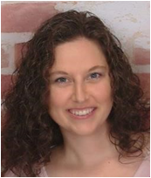
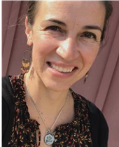
Arts & Culture
Nicole Braun
Sara Keys
Notes:
Our Arts & Culture Community Service Program is lead by Nicole Braun & Sara Keys.

Slide 8
Arts & Culture
Visual & Fine Arts
Crafts
Performing Arts
Photography
Creative Writing
Cultural Awareness
Notes:
The Arts & Culture area is dedicated to enriching the human experience. Project ideas are suggested in the areas of visual & fine arts, crafts, performing arts, photography, creative writing, and culture. Resource organizations that may assist clubs include the National Endowment for the Arts, Very Special Arts, National Association for Music Education, and Americans for the Arts.

Slide 9
Arts & Culture
Challenge Project:
Sponsor a Youth Art Contest.
(March).
Notes:
The Challenge Project for Arts & Culture is to sponsor a Youth Art Contest during March, which is Youth Art Month. Partner with your local schools or other community organizations. Display winning artwork in prominent places in your community. Purchase ribbons or other prizes to award the winning participants

Slide 10

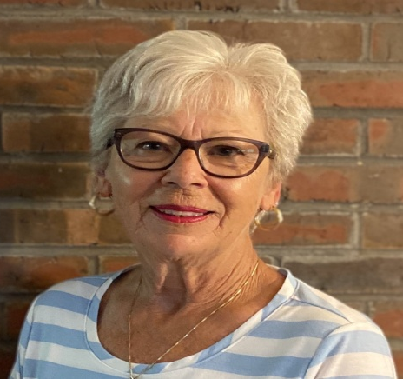
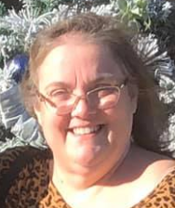
Civic Engagement & Outreach
Sharon Wilkin
Patty Hosea
Notes:
The Civic Engagement & Outreach CSP is lead by Sharon Wilkin & Patty Hosea.

Slide 11
Civic Engagement & Outreach
Citizenship
Crime Prevention
Safety
Disaster Preparedness
Support for Needy, Hungry, Homeless
Military & Veterans
Notes:
The Civic Engagement & Outreach program reminds members that each of us is a part of a larger society and is responsible for undertaking actions that will create a better quality of life and foster a sense of community. Included here are citizenship, crime prevention, safety, disaster preparedness, programs for the needy, hungry, and homeless, and our military personnel and veterans. Several organizations are resources for projects in this program, such as HOBY, the American Legion, Fisher House, Habitat for Humanity, National Council on Aging, Wreaths Across America, Honor Flight, KIVA, Samaritan’s Purse, and the National Coalition for Homeless, to name a few.

Slide 12
Civic Engagement & Outreach
Challenge Project:
Support/celebrate women veterans
(November)
Notes:
The Civic Engagement Challenge Project is to support or celebrate women veterans in your community during the first two weeks of November. Most of us think of males when we picture a veteran, but just remember that we females have played an important part in the United States armed forces. Celebrate the accomplishments of our female military personnel with projects directed especially to their needs.

Slide 13

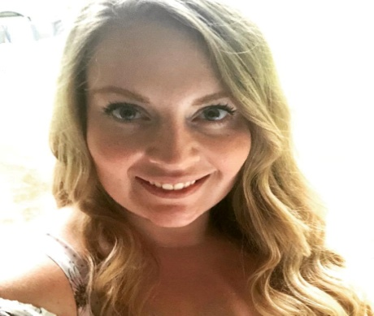
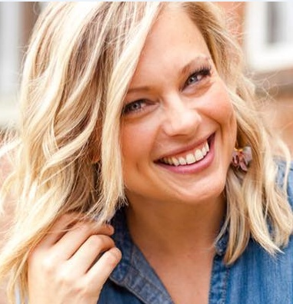
Education & Libraries
Amelia Massey
Lindsey Moore
Notes:
Our Education and Libraries CSP is headed up by Amelia Massey and Lindsey Moore.

Slide 14
Education & Libraries
Schools
Literacy
Libraries
Books
Notes:
The Education & Libraries area promotes education in both children and adults. It aims to help others, while continuing to learn. Projects are designed to foster schools, as well as other educational institutions and opportunities. Its goal is to promote literacy, libraries, and the love of a good book. Organizations that may provide resources in this area include Books Alive, National Education Association, Read Across America, STEM, The Library Project, HOBY, 1000 Book Challenge, and Reach Out and Read.

Slide 15
Education & Libraries
Challenge Project:
Sponsor a STEM event with Special Needs students
(October)
Notes:
The Challenge Project is to sponsor a STEM event with Special Needs students during Disability History Month in October. There are several websites noted in the plan of work that will assist clubs in finding appropriate projects to help our disabled students have fun with science, technology, engineering, and mathematics.

Slide 16

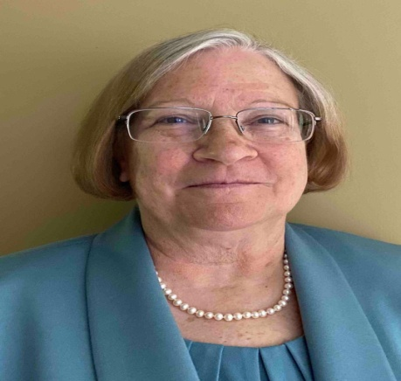
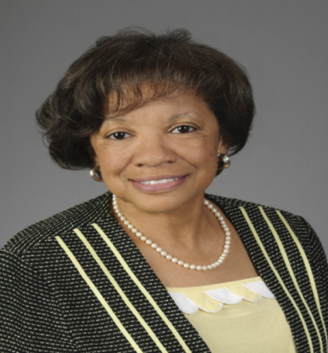
Environment
Julie Bates
Judine Heard
Notes:
The Environment Community Service Program is chaired by Julie Bates and Judine Heard.

Slide 17
Environment
Sustain Life
Enjoy Nature
Beautify Communities
Preserve Natural Resources
Protect Wildlife & Domesticated Animals
Notes:
The Environment encourages us to become stewards of the earth by living sustainably, enjoying nature, and beautifying our communities. We are urged to preserve the world’s resources, and protect wildlife and domesticated animals. Organizations that may provide resources for members include the Audubon Society, National Parks Conservation Association, Soles 4 Souls, World Wildlife Fund, the Department of Environment and Natural Resources, and the Arbor Day Foundation.

Slide 18
Environment
Challenge Project:
Create something from recycled plastic
Notes:
The Challenge Project is a special contest sponsored by the chairmen to create something from recycled plastic. Clubs should document the project throughout the process with photographs. The more pieces of plastic used, the more points will be awarded to the finished product. Deadline for submission is our reporting deadline of January 25th at 11:59 PM.

Slide 19

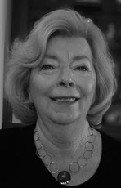
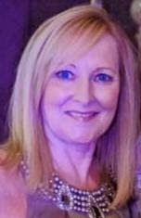
Health & Wellness
Diane Norris
Sheila Sanchez-Vesga
Notes:
The Health & Wellness CSP is lead by Diane Norris and Sheila Sanchez-Vesga.

Slide 20
Health & Wellness
Nutrition
Disease Prevention
Physical & Emotional Care
Notes:
The Health & Wellness area aims to explore the various opportunities for awareness and advancement of nutrition, disease prevention, and physical and emotional care. Resource organizations offering assistance may include the Center for Disease Control and Prevention, National Heart, Lung, and Blood Institute, Growing Minds, Easter Seals, Prevent Child Abuse America, and St. Jude Children’s Research Hospital. Both our President and Director of Junior Clubs have special projects that will be reported in this CSP.

Slide 21
Health & Wellness
Challenge Project:
Educate, advocate, donate to Mental Health Program
(May)
Notes:
The Challenge Project for Health & Wellness is to educate, advocate and/or donate for a mental health program during May. Some project ideas include sponsoring and participating in a walk, run, swim event, or dance-a-thon with benefits funding a mental health program of your choice.

Slide 22








AFFILIATE ORGANIZATIONS
Notes:
GFWC Affiliate Organizations offer unique and customized services, including: materials, speakers, kits, and/or additional information specifically designed for GFWC clubs.
Currently, GFWC has partnered with: .
Heifer International
Hugh O’Brien Youth Leadership (HOBY)
March of Dimes
Prevent Child Abuse America
Operation Smile
Shot At Life
St. Jude Children’s Research Hospital
UNICEF
Clubs will find suggestions for working with these GFWC Affiliates in the Plans of Work in each of the Community Service Programs. Some Affiliates have projects in multiple CSP areas. So, remember to report your projects based upon its intent. And if you have questions, don’t hesitate to call one of our chairmen.

Slide 23

Advancement Areas
Notes:
Tier II includes the GFWC Advancement Areas.

Slide 24
Advancement Areas
Communications & Public Relations
Fundraising & Development
Leadership
Legislation & Public Policy
Membership
Women’s History
Notes:
Our GFWC Advancement Areas include: Communications & Public Relations, Fundraising & Development, Leadership, Legislation & Public Policy, Membership, and Women’s History & Resource Center. There are great project ideas listed in our GFWC Georgia Plan of Work and of course, on the GFWC website.

Slide 25



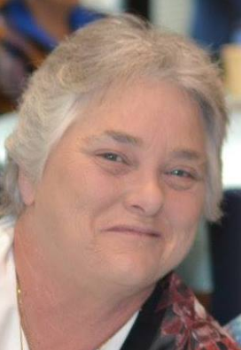
Advancement Areas
Mary Beth Jacobson
Brenda Gramm Suzanne Mashburn
Notes:
Communications and Public Relations encompasses the newsletter, social media, the website and the Clubwoman Magazine. Mary Beth Jacobson is our committee chairman.
The Fundraising Committee is chaired by Brenda Gramm and Suzanne Mashburn. You’ll find lots of great ideas for increasing your club’s treasury or raising funds for a special project.

Slide 26


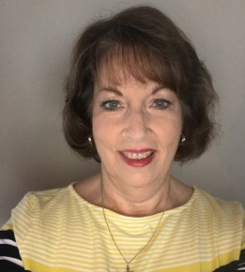
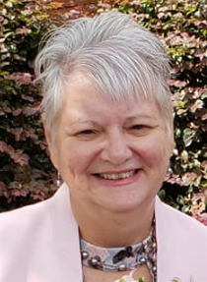
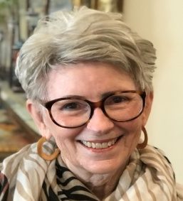
Advancement Areas
Leadership
Becky Bolden Diane DeGaetano
Jo Dee Gonzalez
Legislation & Public Policy
Notes:
Our Leadership chairmen are Becky Bolden and Diane DeGaetano. Opportunities to lead our organization are described, as well as ways to learn to become a better mover or shaker in your club. Legislation and Public Policy Chairman is Jo Dee Gonzalez. Ways to become involved in our political process are described in this section.

Slide 27
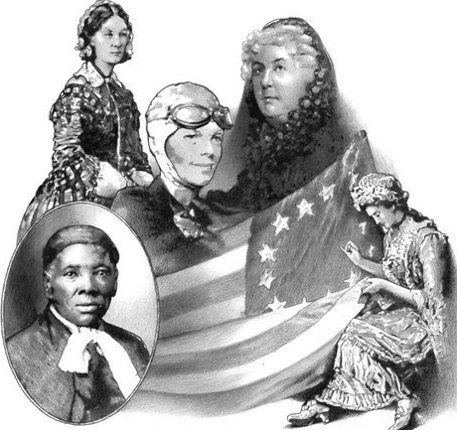

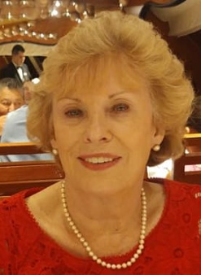
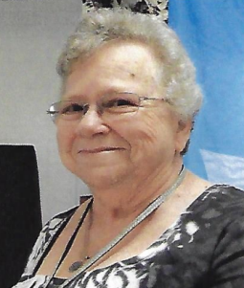
Advancement Areas
Membership
Peggy Wilson
Women’s History & Resources
Pat Turner
Notes:
Our 3rd Vice President, Peggy Wilson, chairs the Membership team. She has developed some Keys to Membership that will help you retain and recruit members.
Pat Turner leads our Women’s History & Resources program. GFWC has a legacy of wonderful women who paved the way for our organization. And we are making history every day within our communities. The Women’s History and Resource Center collects, preserves, interprets, and promotes the history of the GFWC and women volunteers. The WHRC documents the social and political contributions of GFWC clubwomen from 1890 to the present through the GFWC archives, related special collections, and publications.

Slide 28

Special Program/Emphasis Areas
Notes:
Don’t let the size of the top of our pyramid fool you! Tier III contains many Special Programs and Emphasis Areas.

Slide 29


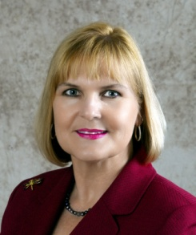
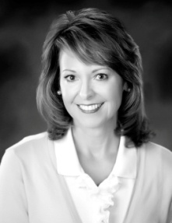
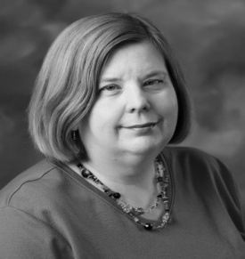
Special Programs/Emphasis
GFWC Signature Project:
Domestic Violence
Patty Gabilondo
GFWC Jr. Emphasis:
Advocates for Children
Sandra Huey Kathryn Youles
Notes:
Patty Gabilondo will chair the GFWC Signature Project, Domestic Violence Prevention & Awareness. This project has been GFWC’s focus for many years. The plan of work encompasses Intimate Partner Violence, Child Abuse, Teen Dating Violence, Campus Sexual Assault, Elder Abuse, Violence Against Native American Women, Military Sexual Assault, and Human Trafficking.
Sandra Huey and Kathryn Youles will lead the GFWC Junior Emphasis Project, Advocates for Children. This project is designed to provide a voice for children and to teach and encourage parents and other caregivers to advocate for children at the grassroots level.

Slide 30
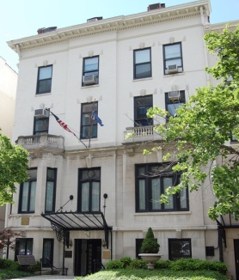

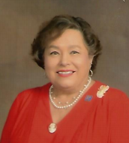
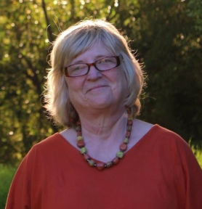
Special Programs/Emphasis
1734 Society
Dianne Barlow
Community Impact Project
Debby Vanderbunt
Notes:
Our GFWC International Headquarters, located at 1734 N Street in Washington DC, benefits from donations to the 1734 Society. Dianne Barlow will chair this project.
What was formerly the Community Improvement Program is now entitled the Community Impact Project. This is a two year project. Debby Vanderbunt is our Georgia chairman.

Slide 31


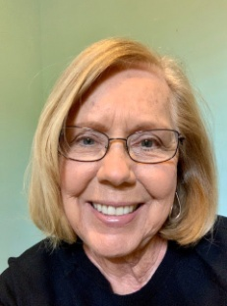
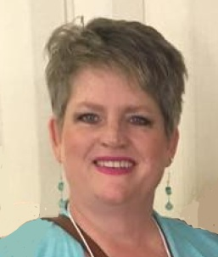
Special Programs/Emphasis
Epsilon Sigma Omega (ESO)
Libby Bond
Ella F. White Foundation
Barbara Reynolds
Notes:
Libby Bond is our Georgia chairman for Epsilon Sigma Omicron. ESO is an honorary educational society open to all per-capita paying GFWC federated club members. Through ESO, clubwomen are given direction in planned reading for self-enrichment and personal growth.
GFWC Georgia is fortunate to have an endowment fund named in memory of Ella F. White. Barbara Reynolds chairs this committee which ensures that our investments are handled wisely.

Slide 32

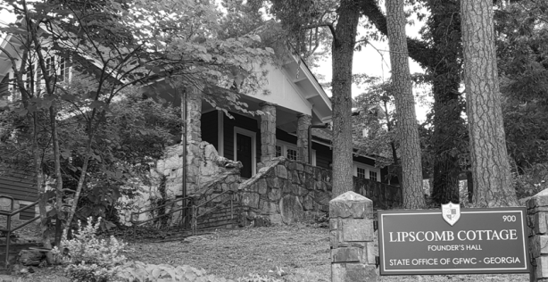
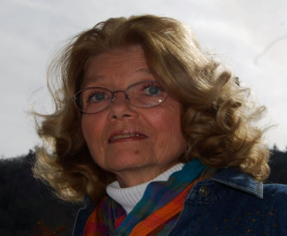
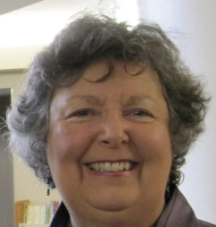
Special Programs/Emphasis
Lipscomb Society
Martha Lee Sherman
Tallulah Falls School
Linda Mote
Notes:
Our Georgia federation headquarters is located at 9 School Road on the campus of Tallulah Falls School in the Lipscomb Cottage. This historic building is maintained through donations to the Lipscomb Society. Martha Lee Sherman serves as chairman.
GFWC Georgia founded Tallulah Falls School in 1912. Even though our federation no longer owns and operates the school, our organization still supports its efforts to educate the children of north Georgia. Linda Mote will chair the TFS committee.

Slide 33

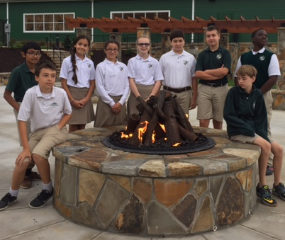
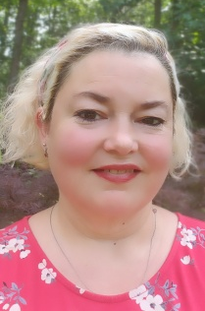
Special Programs/Emphasis
GFWC Ga President’s Special Project:
Food Allergy Research Education
Laedenia Jewel
GFWC Ga Presidents TFS Project:
“The Commons”
Notes:
Shelby Holland, our GFWC Georgia President, has selected Food Allergy Research Education or FARE as her special emphasis project. Laedenia Jewell will serve as chairman. Projects conducted for this project will be reported in the Health & Wellness CSP.
Shelby’s special project for Tallulah Falls School is to raise funds for the Commons area-a place where students can enjoy relaxing and communing outdoors with each other. Projects will be reported in the Education & Libraries CSP.

Slide 34

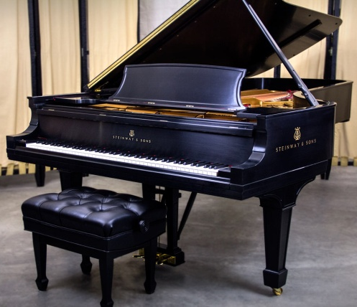
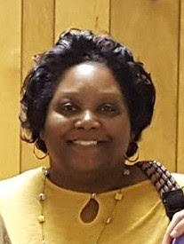
Special Programs/Emphasis
Jr. Director Special Project
Shantelle Grant
Jr. Director TFS Project:
“The Steinway”
Notes:
Dana Skelton, our GFWC Georgia Director of Junior Clubs, selected Mental Health and Invisible Disabilities as her special emphasis project. Shantelle Grant will lead this effort. All projects should be reported in the Health & Wellness CSP.
The refurbishing of the Steinway piano is Dana’s special project for TFS. Report your club projects for the piano project in Arts & Culture.

Slide 35
Changes in Review
6 CSP 5 (International Outreach dissolved)
CSP names changed
Art Arts & Culture
Conservation Environment
Education Education & Libraries
Home Life Health & Wellness
Public Issues Civic Engagement & Outreach
Community Improvement Program Community Impact Project
Notes:
So, to recap the changes. GFWC has merged our Community Service Programs from six to five, dissolving the International Outreach program. Any projects that were suggested for this program have been reassigned. The titles of the five CSPs have been changed. Art is now Arts & Culture; Conservation is now Environment; Education is now Education & Libraries; Home Life is now Health & Wellness; and Public Issues is now Civic Engagement & Outreach.
The Community Improvement Program has been renamed to Community Impact Project.

Slide 36

Notes:
All of this information is located in the GFWC Georgia Yearbook. All clubs are encouraged to purchase at least one printed copy to ensure you have the most up-to-date and accurate information for the 2020-22 Administration.

Slide 37

GFWC Georgia Yearbook
Notes:
It’s a bargain at only $20.
This valuable reference includes contact information, Plans of Work in all three tiers, By Laws, Standing Rules, and forms. The Yearbook will also soon be available on the website for download.

Slide 38

Notes:
And of course, I guess it goes without saying, you gotta read the thing!

Slide 39

“Everything You Want to Know About REPORTING, But Are Afraid to Ask”
gfwcgeorgia.org
Notes:
Check out the changes and directions for your Annual Report on our GFWC Georgia Website, entitled “Everything You Want to Know About REPORTING, But Are Afraid to Ask.”

Slide 40
A Servant Heart
Available
(2) Sensitive & Spontaneous
(3) Confident
(4) Dedicated
(5) Faithful
Notes:
True volunteers have a servant heart. First, they are available to serve, willing for their schedules to be interrupted and do what’s needed even when its inconvenient. Second, they are sensitive and sometimes spontaneous. A club woman pays attention to needs in their community and looks for ways to help others. A person with a servant heart is confident. They do the best they can with what they have. There are no excuses, no procrastination, and no fear that they are not good enough. Each task is undertaken with equal dedication. The size of the task is irrelevant. Menial jobs that others might not think of doing are completed. And finally, the servant heart volunteer is faithful. Responsibilities are fulfilled. Promises are kept.

Slide 41
Through love serve one another.
Galatians 5:13
Notes:
Galatians 5:13 reminds us that through love we should serve one another. This is the servant’s heart mentality. It means to help others in love without expecting something in return, to serve in appreciation of the gifts God has already given us.
I am reminded of a song I taught my students long ago. It goes something like this:
Make me a servant.
Humble and meek
Lord let me lift up those who are weak
And may the prayer of my heart always be
Make me a servant today
May you be inspired to serve others with humility, love, and compassion. I am confident that you will.

