Slide 1
ENVIRONMENT COMMUNITY SERVICE PROGRAM
JULIE BATES, CHAIRMAN
JUDINE B. HEARD, CO-CHAIRMAN
Environment@GFWCGeorgia.org

Slide 2

ENVIRONMENT
CHALLENGE PROJECT
2020 - 2022
Reduce, Reuse, Repurpose, & Recycle
Best Reduce Plastic Project

Slide 3
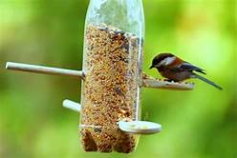
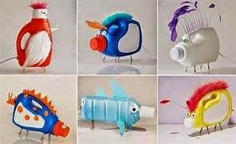
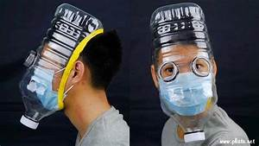
Create, build, and produce something reusable from anything plastic (bags, bottles, etc.). The more plastic used, the more points will be awarded; so tally the amount collected and utilized. The final product should be documented through photographs from beginning to end. Clubs will submit their best Reduce Plastic Project and attach five pictures by the January 25th reporting deadline to the Environment online report. Certificates will be awarded each year to a first, second, and third place winner. Make something of value that can be used.

Slide 4
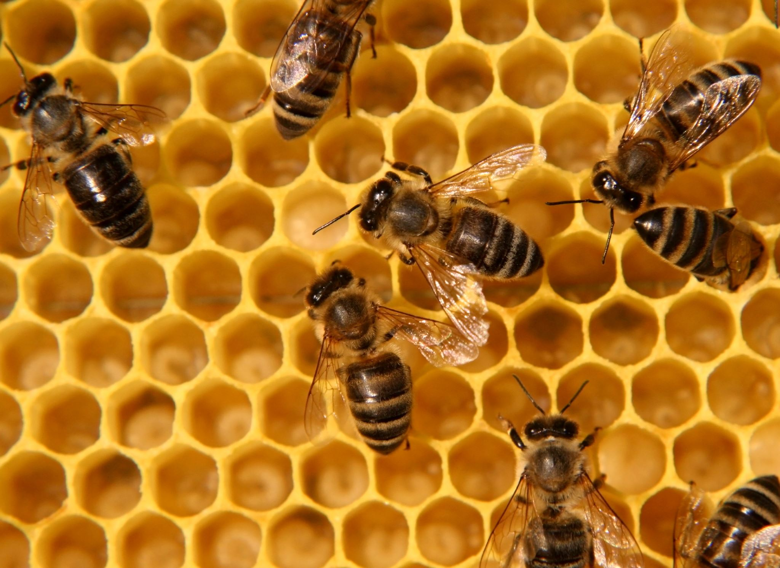
Jane Goodall stated:
"You cannot get through a single day without having an impact on the world around you. What you do makes a difference and you have to decide what kind of difference you want to make."
Our presentation breaks down this CSP as World Resources (Air, Land, and Water), Sustainability Lifestyle, Wildlife and Domesticated Animals, and Nature and Beautification.
The environment is where you can make a difference.

Slide 5

Focus of Three Areas of Environment
Air
Land
Water

Slide 6
Air
Clean air is essential for our planet and the health of all of us.
We depend on the air we breathe, yet the air is filed with hazardous contaminants, making it more difficult to enjoy and potential health problems.
There are two types of air pollutions dominate in the U.S. - ozone and particle pollution.*
Air is important to our animals, including the Monarch butterfly.
Source: American Lung Association - http://www.stateoftheair.org/health-risks/
Notes:
While many of us don’t live in a congested city such as Atlanta, we do have to think about other problems – such as smoke stacks of Savannah.

Slide 7
What You Can Do
Carpool to
  Club meetings
  Club activities
  Work
  Places of Worship
  Children’s after-school activities
Walk when possible
Purchase from local farmers
Create a butterfly garden
Notes:
Often we think it is inconvenient to carpool

Slide 8
Club Activities
Educate members and the community on butterflies.
  Visit and volunteer
    Callaway Gardens
    Chattahoochee Nature Center
    Dunwoody Nature Center
    Savannah-Ogeechee Canal Museum and Nature Center
    Freedom Park Bird and Butterfly Garden

Slide 9
Land
Litter clean-up costs the U.S. more than an estimated $11.5 billion each year.*
According to GDOT, it only takes 1 hour for chemicals to leach from cigarette butts when in contact water.
Animals can get caught in plastic items and become injured.
Litter-causing water pollution can impact recreation areas and drinking water supplies.
*Source: Keep America Beautiful, Inc. - www.kab.org.

Slide 10
What You Can Do
Keep a litter bag in your car.
For smokers, keep a designated place in your car for cigarette butts and ashes until you’re ready to throw them away.
Properly cover trash receptacles outside to prevent litter escaping.
Encourage friends & family to take pride in their community and not to litter.
Make a small change – pick up one piece of litter each day.

Slide 11
Club Activities
Organize a community clean-up.
Consider participating in Georgia’s Adopt-A-Highway Program your city or county program.
  Contact Information:
    Georgia Department of Transportation
    GDOT Adopt-A-Highway Program
    (404) 631-1387
    landscape@dot.ga.gov
    http://www.dot.ga.gov/DS/Travel/AdoptHwy

Slide 12
Water
Water is an essential element for life.
Water affects all parts of life.
Our planet would look different without water.

Slide 13
What You Can Do
Turn water off when doing such things as washing your hair, brushing your teeth, even rinsing dishes.
Purchase water-efficient home products for toilets and laundry equipment.
Wash full loads of clothes or dishes.
Minimize the amount of time you water your lawn. Consider rainwater harvesting.

Slide 14
Use environmentally friendly chemicals for cleaning.
Make your own cleaning supplies.

Slide 15
Club Activities
Help protect Georgia’s waterways by participating in the Adopt-A-Stream program.
Experience is not necessary; and training workshops are provided throughout the state.

Slide 16
SUSTAINABILITY LIFESTYLE
● Support recycling programs in your community.
● Coordinate a children’s poster contest on recycling.
● Initiate a “Go Paperless” campaign in the community.
● Reuse or recycle glass containers.
● Organize a special event to commemorate America Recycles Day on Nov. 15th.
● Reuse plastic bags as liners in small trash cans.
● Recycle water bottles and disposable cups.
● Send old appliances to recycling centers rather than donating them to organizations.
● Make old t-shirts into grocery bags.

Slide 17
(SUSTAINABILITY LIFESTYLE CONTINUED)
● Donate old clothing.
● Hold a club yard sale to repurpose gently used items and donate the proceeds to various environmental charities.
● Utilize reusable shopping bags.
● Carry reusable water bottles or travel mugs.
● Purchase laptop computers rather than desktop computers because they use less energy

Slide 18
WILDLIFE AND DOMESTICATED ANIMALS
● Support local animal shelters.
● Preserve natural habitats to protect wildlife.
● Advocate for and support regulations that limit light pollution, which is dangerous to nocturnal wildlife and disruptive to ecosystems.
● Educate the club and the community members about the importance of pollinators and how to create healthy habitats where they can thrive.
● Support and visit the Callaway Gardens Butterfly House.
● Educate members or the community on ocean wildlife in peril, such as sea turtles and manatees.
● Support and visit the Georgia Sea Turtle Center on Jekyll Island.
● Offer a workshop on building birdhouses and provide information on bird species, their characteristics and behaviors, and their varying habitat requirements.

Slide 19
NATURE AND BEAUTIFICATION
● Adopt a spot in the community to landscape or maintain existing plants.
● Sponsor a “Yard of the Month” beautification project that recognizes community enhancement.
● Plant native plants to Georgia.
● Provide a program for the club and the community members that highlight the best native plants for food and cover.
● Establish a biking or hiking trail in the community or maintain an existing trail.
● Sponsor events to focus on beautiful nature spots.
● Organize local garden tours. ● Donate funds to a community garden or conservation program
● Donate funds to a community garden or conservation program

Slide 20
Contacts
Georgia Adopt-A-Stream
404-651-8515
aas@dnr.ga.gov
https://adoptastream.georgia.gov

Slide 21
Recycling Markets Around Georgia
  https://docs.google.com/spreadsheets/d/1YtPAVz33qSa7pZrFGgVRajgOeM1T0gHUbXV8fTrheVY/edit#gid=0
Litter in America
  https://static1.squarespace.com/static/5c361f2fec4eb7166c0d6773/t/5d67ead3e0d47900019d8150/1567091412225/LitterinAmerica_FactSheet_CostsofLittering.pdf
Keep Georgia Beautiful
  https://www.keepgeorgiabeautiful.org/
Community Farmers Markets
  http://agr.georgia.gov/community-farmers-markets.aspx
Air Quality Index
  https://www3.epa.gov/airnow/aqi_brochure_02_14.pdf

Slide 22
Ambient Air Monitoring Program
  https://airgeorgia.org/
Georgia Commute Options
  https://gacommuteoptions.com/

Slide 23
GFWC Georgia – Environment CSP
Pages 123 – 128 of 2020-2022 Yearbook as of August 18, 2020

Slide 24


HEIFER INTERNATIONAL Heifer promotes agroecology, working with farmers to integrate climate-smart agricultural practices to increase resilience and crop production (www.heifer.org/gift-catalog/caring-for-the-earth/index.html). • At your next meeting or community event, set up a table to promote the goal of donating a bee-hive. Wear bee antennae headbands to draw attention to the project. For any donation, offer a packet of wildflower seeds to promote local bee activity. Have information about Heifer and your own club available.
UNICEF Is your community a child friendly city? UNICEF USA Child Friendly City Initiative brings a flexible, dynamic, child-rights focused framework, communities are improved as neighborhoods become safer, schools and health systems function better, and infrastructure is strengthened for all citizens (www.unicefusa.org/mission/usa/childfriendlycities). • Present information and videos from UNICEF USA initiative about the need for accessible clean water and the significant difference it makes in the lives of women and children (www.unicefusa.org/mission/survival/water)

